Slide 1
Descriptive Statistics

Slide 2
Descriptive Statistics
~ A set of techniques for summarizing and displaying data.
Your research question will probably about the relationship between two or more variables, but it is still important to look at your data and describe your variables individually.

Slide 3
Before we start…
Go download JASP (Jeffrey’s Amazing Statistical Program)
https://jasp-stats.org/
Click Download at the top, or go to:
https://jasp-stats.org/download/
Available for windows/mac/linux
Download version 0.10.1.0
Download & Installation ~ 10 minutes
Why are you making me do this?
Problems? Email-me and we’ll figure it out!

Slide 4
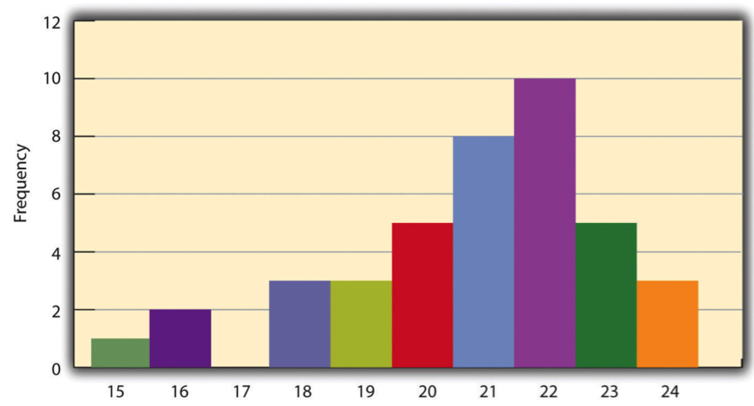
Distribution of a variable
Self-Esteem | Frequency
24 | 3
23 | 5
22 | 10
21 | 8
20 | 5
19 | 3
18 | 3
17 | 0
16 | 2
15 | 1
~ the way the scores are distributed across the levels of that variable.
How to display the distribution
Frequency Tables
Table with all possible levels/values, and the frequency/how many occur at each level
If you have continuous variables, tables can get long!
Histograms
Graphical display of a distribution.

Slide 5
How to in JASP
Download booksales.csv from Week 8 module.

Slide 6
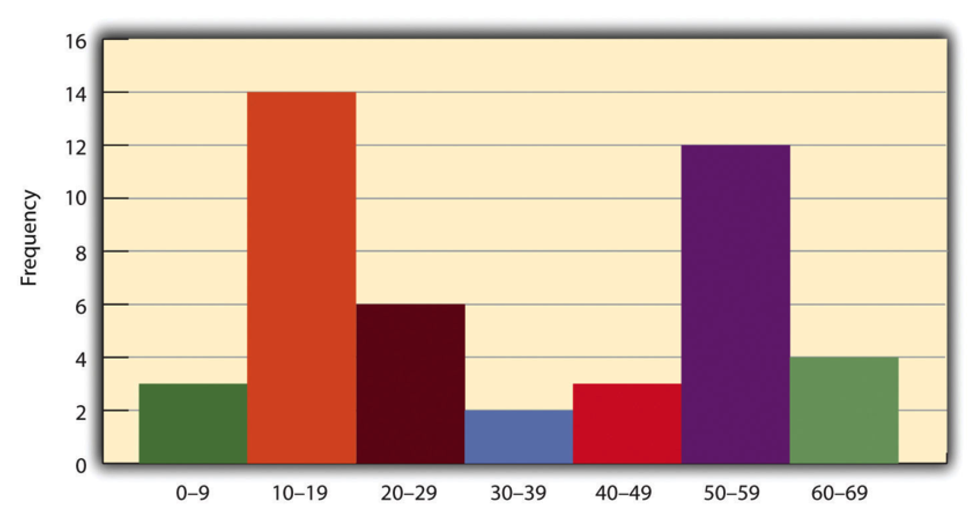
Distributional Shapes
All histograms have shapes.
Typical histograms have peak in the middle and tail off to the sides.
Unimodal
Bimodal

Slide 7
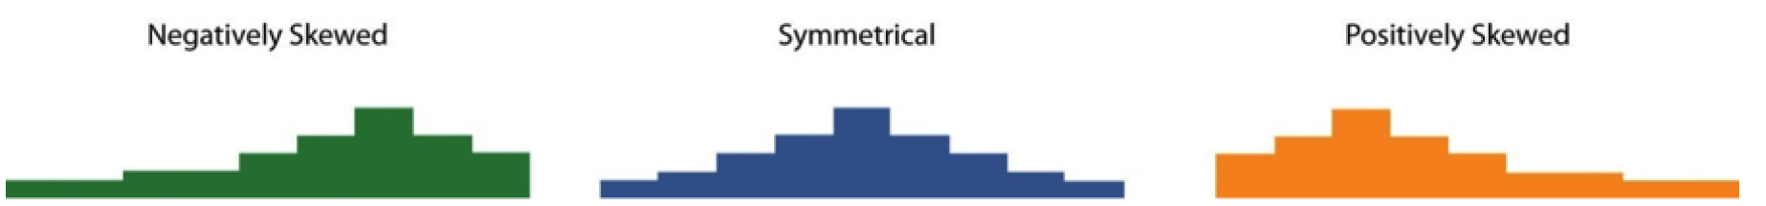
Distributional Shapes
Is it symmetrical? (skew)

Slide 8
Measures of Central Tendency
Central tendency – the middle of a variable’s distribution
Mean
Sum of the scores divided by the number of scores
Median
The middle number
Mode
The most frequent score in a distribution

Slide 9
How to in JASP
Still using booksales.csv

Slide 10
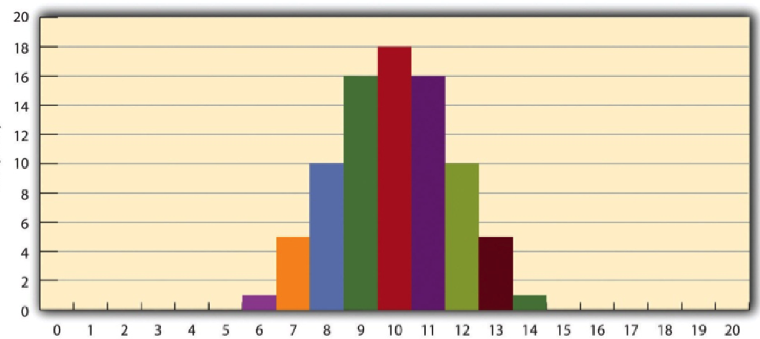
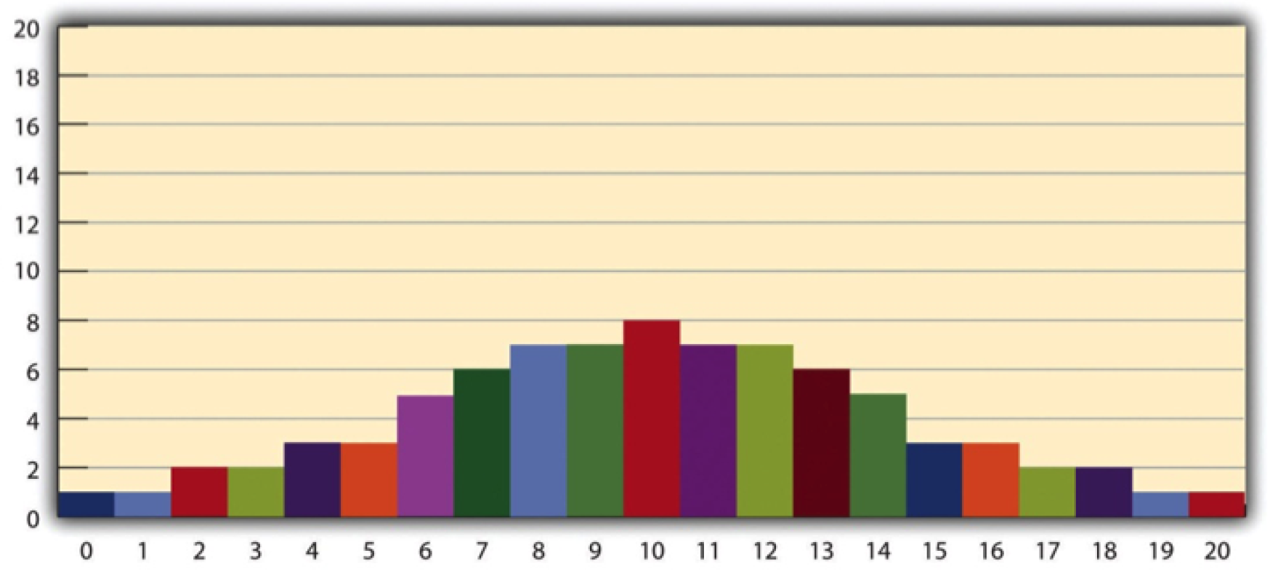
Variability
Variability – extent to which scores vary around their central tendency

Slide 11
Variability
Range – Difference between the highest and lowest scores
Standard Deviation (SD) – average distance between the scores and their mean
Variance – the mean of the squared differences (SD²)

Slide 12
How to in JASP
Still using booksales.csv

Slide 13
Percentile Rank & z-scores
Percentile rank – percentage of scores in a distribution that are lower than that score
Z-score – difference between that individual’s score and the mean of the distribution, divided by the standard deviation of the distribution
Comparing apples and oranges

Slide 14
How to in JASP
Still using booksales.csv
Z-score- where does 31 fall? We need the following info: mean & SD
(31 – 30.417) / 0.9 = .648
31 is 0.648 SD above the mean
For z-scores, will need a tin tiny bit of code
scale(as.numeric(as.character(Days)))

Slide 15
Statistical Relationships – Difference between groups or conditions
Experiment with 2 groups
Calculate and compare means
Visualize means in a bar graph
Effect size – describes the strength of a statistical relationship
Cohen’s d – the difference between the two means divided by its SD
0.20 Small
0.50 Medium
0.80 Large
Side note: Effect size does not NOT imply a causal relationship.

Slide 16
How to in JASP
Download clinicaltrial.csv from Week 8 module
Calculate means, bargraph, and Cohen’s d effect size

Slide 17
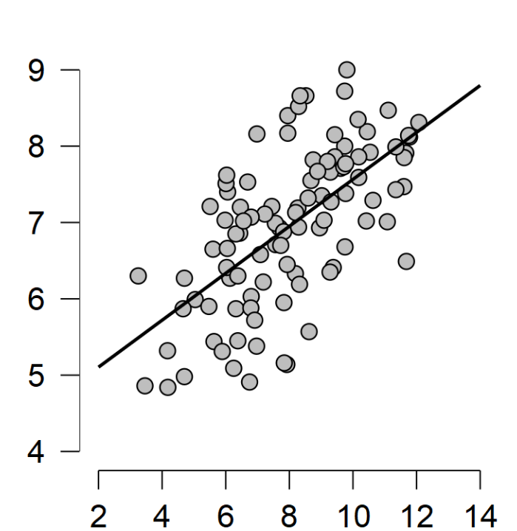
Statistical Relationships – Correlation between variables
Correlation – measure of the relationship between two variables
Scatterplot
Pearson’s r
.10 small
.30 medium
.50 large

Slide 18
How to in JASP
Download parenthood.csv from Week 8 module
Scatterplots, pearson’s r

Slide 19
APA Style for descriptive statistics
Classroom A (M = 5.23, SD = 0.98) had higher test ratings than classroom B (M = 4.92, SD = 1.17).
There was a positive correlation between student test scores in classroom A and classroom B (r = .63, p < .001).

